Slide 1
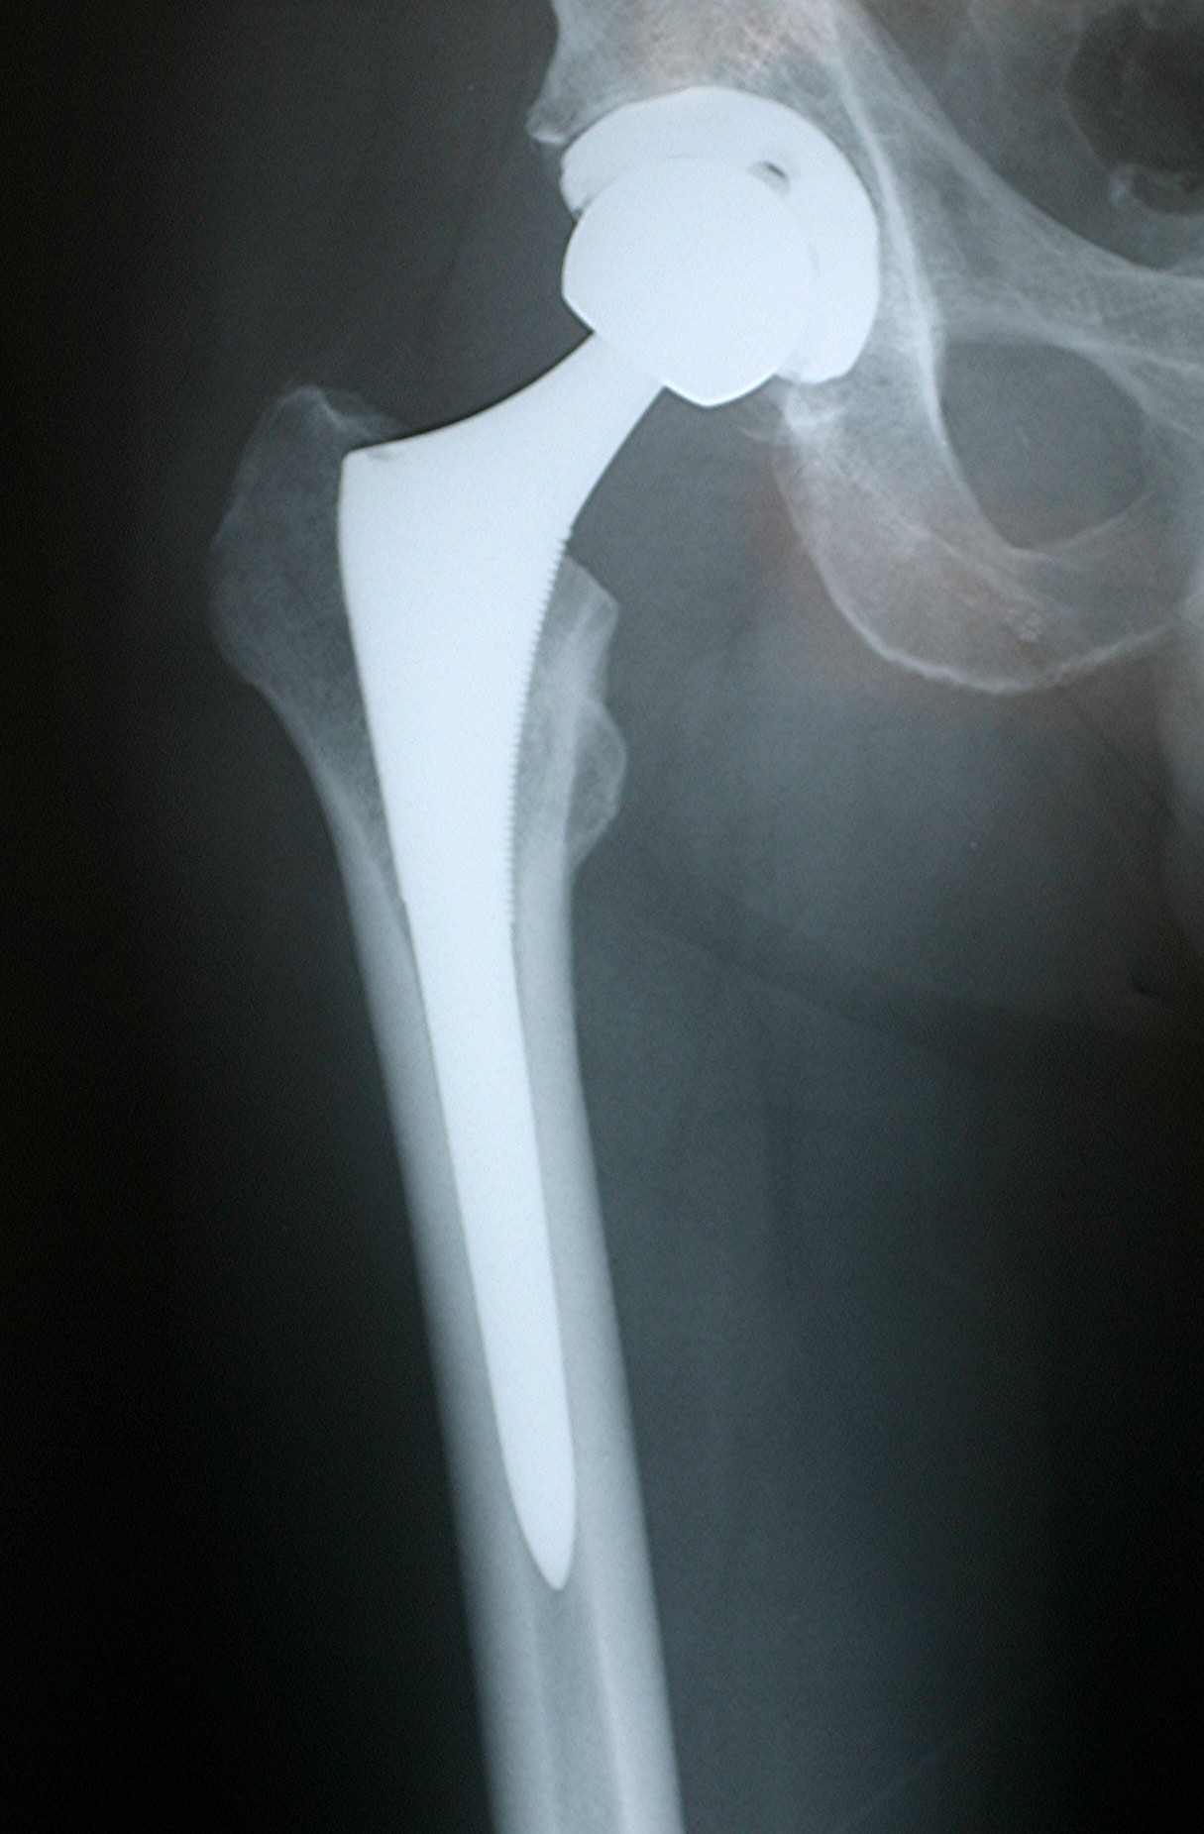
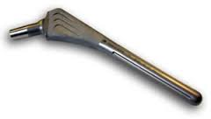
Hip Stem
Function: provides support for hip ball and provides fixation to the femur
Objectives: Must transfer load from ball to femur, must be as light as possible, minimise mass, while maintaining mechanical performance in terms of strength and resisting bucking. Must be biocompatible. Must transfer load evenly to bone and fit into intramedullary canal in femur
Constraints: Elastic modulus similar to bone, maximise strength to weight ratio, non-toxic and biocompatible, must not corrode in vivo.
Free variable: Choice of material
Strength to weight performance Index: $M_{1}=\frac{σ}{ρ}$
The stem is essentially a cylindrical rod:
The compressive load ≤ the Euler bucking load, F ≤ π²EI/L² , where the second moment of area I = πr⁴/4, and mass m = V ρ
Like previous example it can be easily shown that:
Buckling Performance Index $M2 = \frac{E^{1/2}}{ρ}$
Elastic Modulus similar to cortical bone: Performance Index: M₃ ≈ 5 -20 GPa

Slide 2
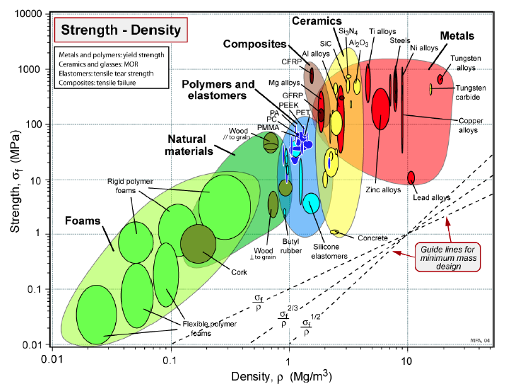
Materials Selection
Bone

Slide 3
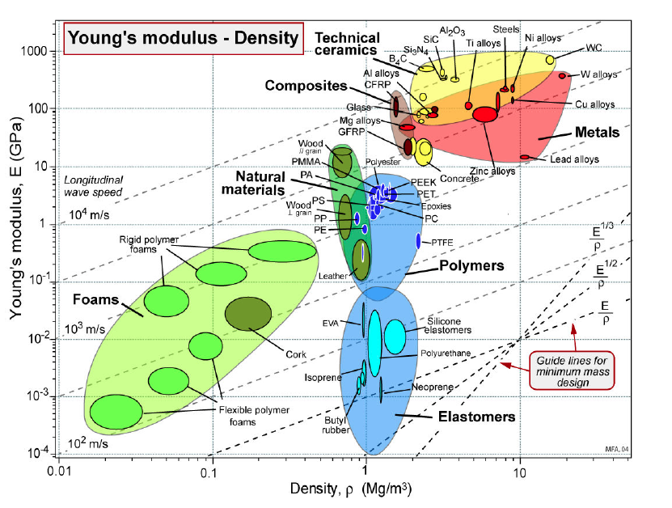
Materials Selection
Bone

Slide 4
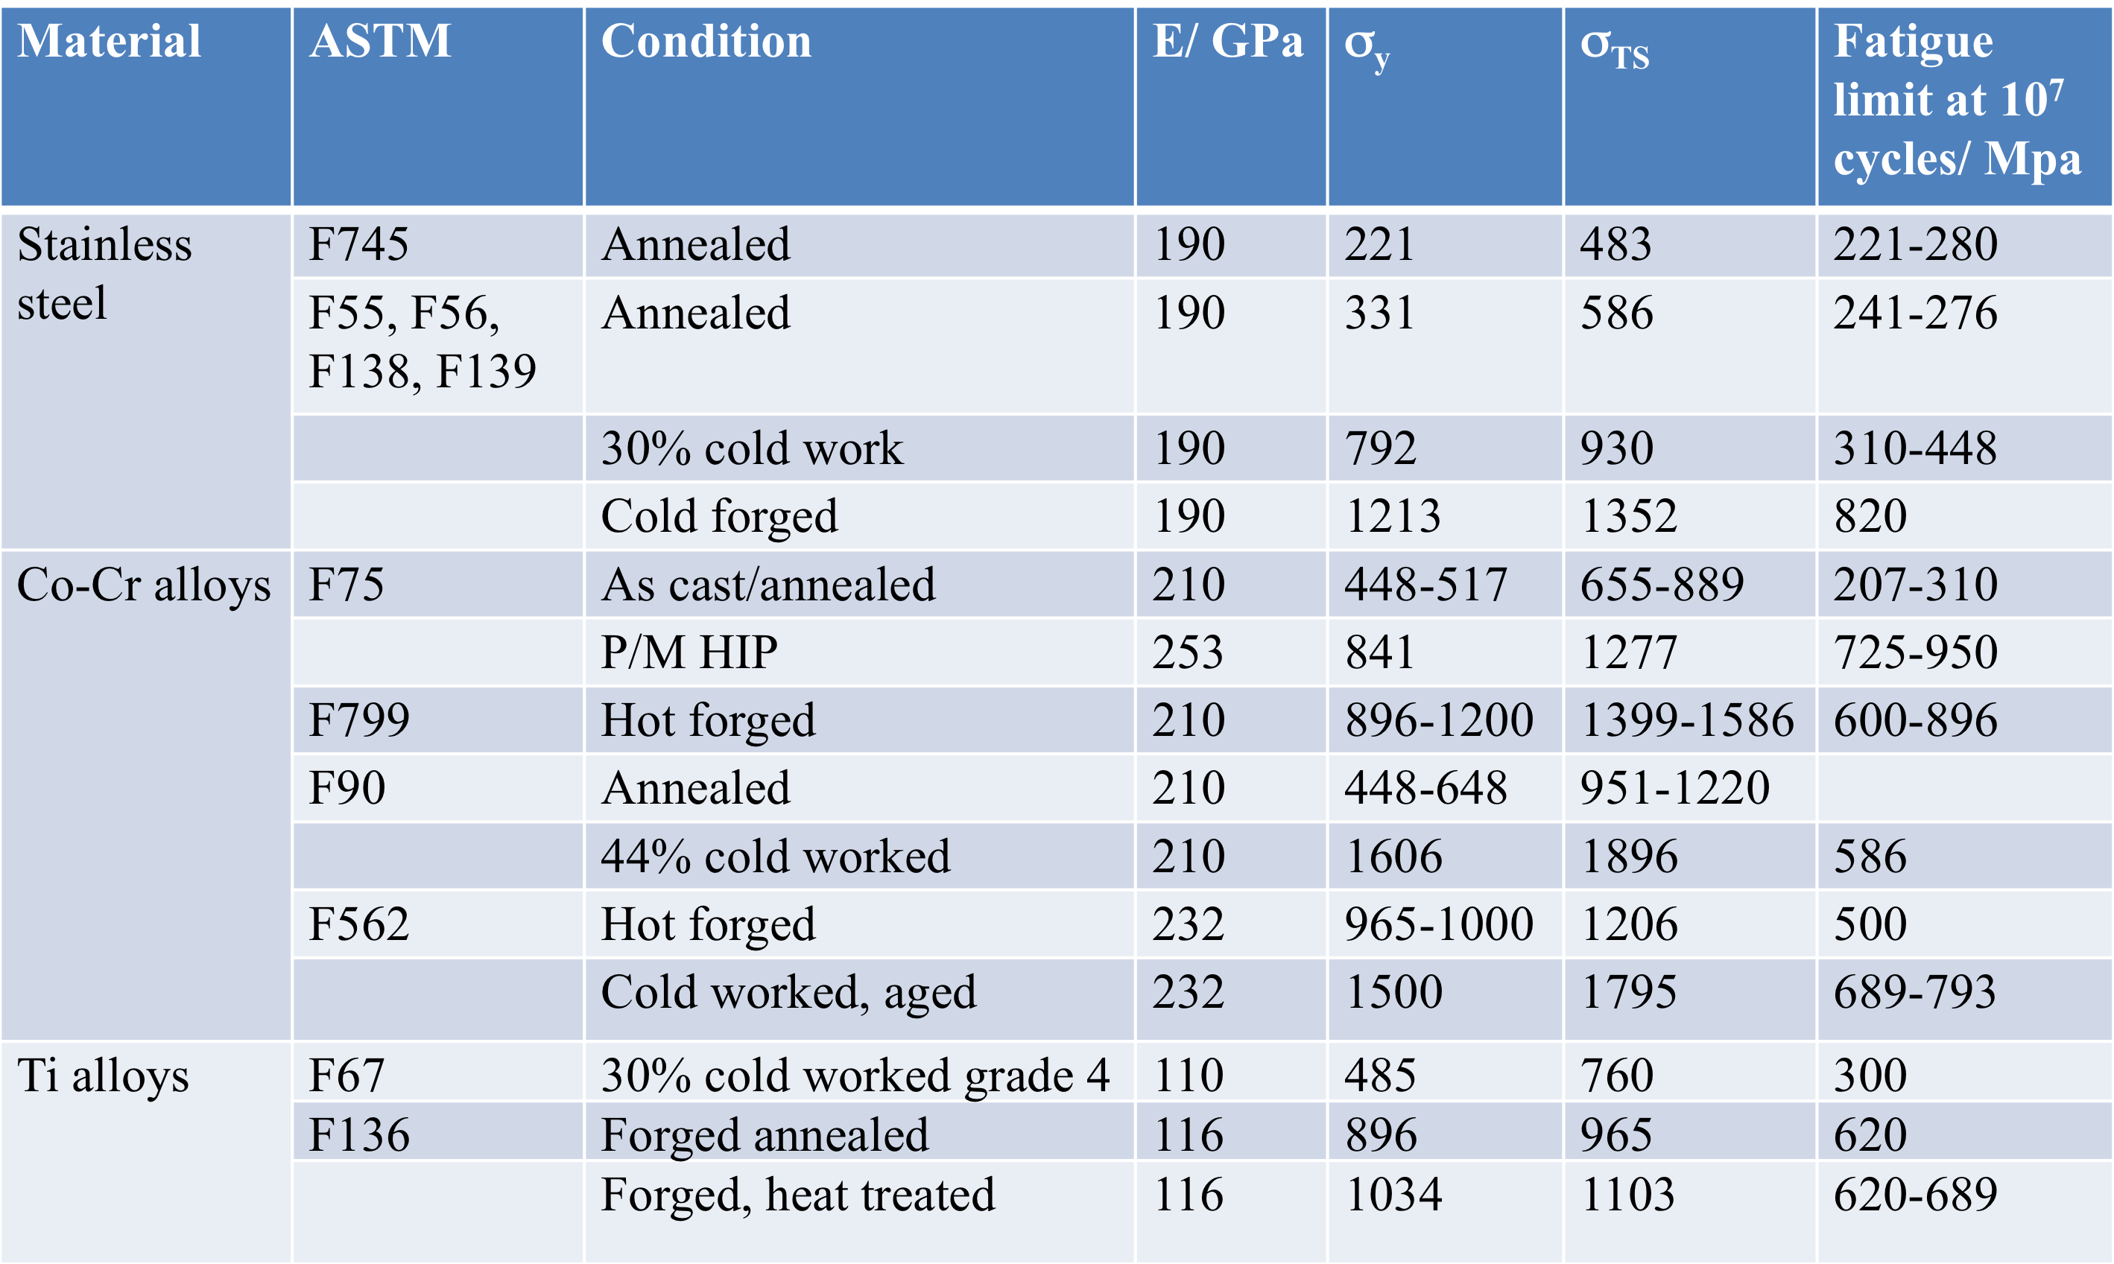
Materials Selection
In reality three different classes of materials are used for metal stems

Slide 5
Materials selection
Taking selected data …. Apply the Materials indexes M₁and M₂ and fill in blanks
Material | ASTM | E/GN.m⁻² | σ_{y}/MN.m⁻² | ρ/Mg m⁻³ | M₁ (σ_{y}/ρ) MNm.kg⁻¹ | M₂ (E^{1/2}/ρ) N^{1/2.}m.²kg⁻¹
SS 316 | F139 | 190 | 1213 | 7.9 | 132 | 55
CoCr alloy | F799 | 210 | 1200 | 9.2 | 130 | 50
Ti alloy | F13 | 116 | 896 | 4.5 | 199 | 76
Additional constraints :
Osteoconductivity: for a cementless implant the metal must have a surface that is osteoconductive ( that is bone will grow up to it). Ti alloys form a natural titania, TiO_{2,} oxide that gives it corrosion protection and also has OH groups on the surface which encourages bone cells to grow up to the surface.
Corrosion resistance: we could also do a selection criteria on this and again Ti has superior corrosion performance, higher pitting potential, compared to stainless steel and CoCr alloys
Therefore Ti alloys are a good materials selection choice

Slide 6
Ti alloys
Which Ti alloy?
Titanium alloys are either α, α + β, or β alloys
A common alloy used for hip stem is an α + β alloy Ti-6wt%Al-4wt%V often shortened to (Ti6Al4)
To see its advantages we need to explore the structure- properties-processing interaction again…

Slide 7
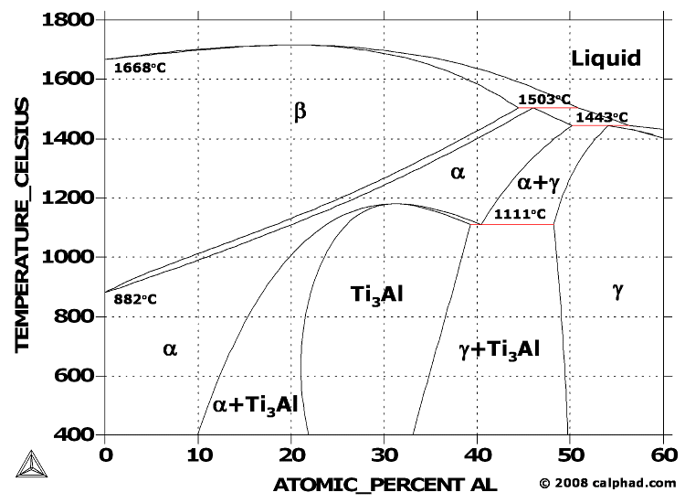

Slide 8
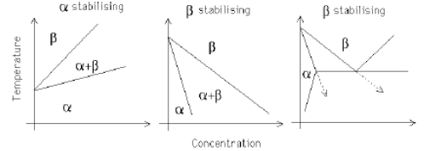
structure - properties - processing
Ti Alloy additions
atoms of elements that form less than four bonds with other atoms, raise the temperature over which α phase is stable (Al, O, N, Ga).
atoms of elements that form four bonds with other atoms (Zr, Sn, Si) tend to be more neutral in their effect on the α an β phases.
atoms of elements that form more than four bonds with other atoms, stabilise β phase either continuously (Mo, Nb, V, W) or sluggishly form a eutectoid (Cu, Mn, Fe, Ni, Co, H ).

Slide 9
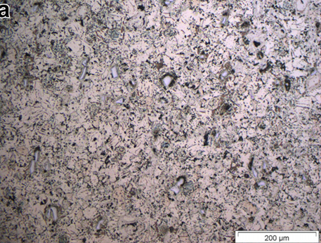
α Ti alloys (Ti-3Al-2.5V)
Ti-3Al-2.5V
Ref: L. Bolzoni, E.M. Ruiz-Navas, E. Gordo, Materials Chemistry and Physics 137 (2012) 608e616
Notes:
Ref: L. Bolzoni, E.M. Ruiz-Navas, E. Gordo, Materials Chemistry and Physics 137 (2012) 608e616

Slide 10
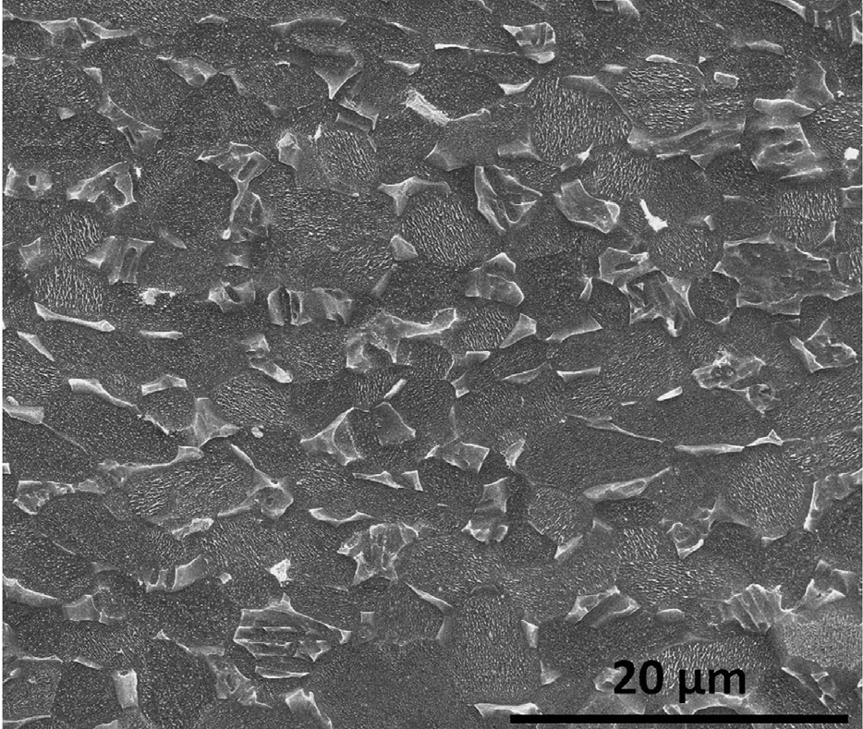
α+β Ti alloys (Ti-6Al-4V)
As-received Ti6Al4V
Ref: Vamsi Krishna Balla, Julie Soderlind, Susmita Bose, Amit Bandyopadhyay, Journal of the Mechanical Behavior of Biomedical Materials, Volume 32, April 2014, Pages 335-344
Notes:
Ref: Vamsi Krishna Balla, Julie Soderlind, Susmita Bose, Amit Bandyopadhyay, Journal of the Mechanical Behavior of Biomedical Materials, Volume 32, April 2014, Pages 335-344

Slide 11
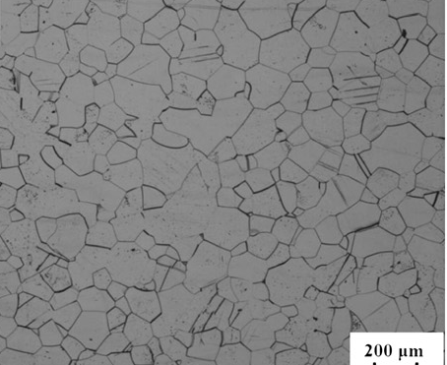
β-Ti alloys (Ti-15Mo)
β
Ti-15Mo after solution treatment
Ref: Jin-Wen Lua, Yong-Qing Zhaoa, Peng Geb, Hong-Zhi Niu, Materials Characterisation 84 (2013) 105-111
Notes:
Ref: Jin-Wen Lua, Yong-Qing Zhaoa, Peng Geb, Hong-Zhi Niu, Materials Characterisation 84 (2013) 105-111

Slide 12
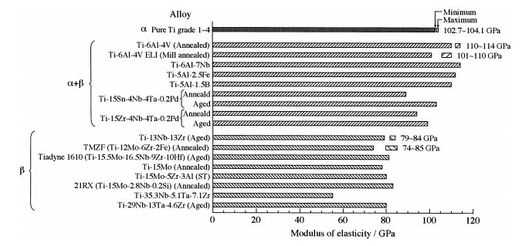
structure - properties - processing
Comparison of modulus of elasticity of titanium alloys
Ref: Mitsuo Niinomi, Materials Science and Engineering A243 (1998) 231–236
Notes:
Ref: Mitsuo Niinomi, Materials Science and Engineering A243 (1998) 231–236

Slide 13
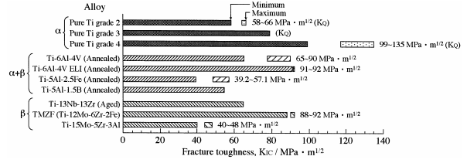
structure - properties - processing
Fracture toughness of biomedical titanium alloy
Ref: Mitsuo Niinomi, Materials Science and Engineering A243 (1998) 231–236
Notes:
Ref: Mitsuo Niinomi, Materials Science and Engineering A243 (1998) 231–236

Slide 14
structure - properties - processing
α alloys have single phase microstructure therefore good weld properties.
The stabilising effect of these high Al alloys also improves strength and oxidation resistance.
Single phase therefore cannot use heat treatment for strengthening.
High percentage of β stabilisers, such as in Ti-13V-11Cr-3Al alloy, cause a predominantly β phase structure.

Slide 15
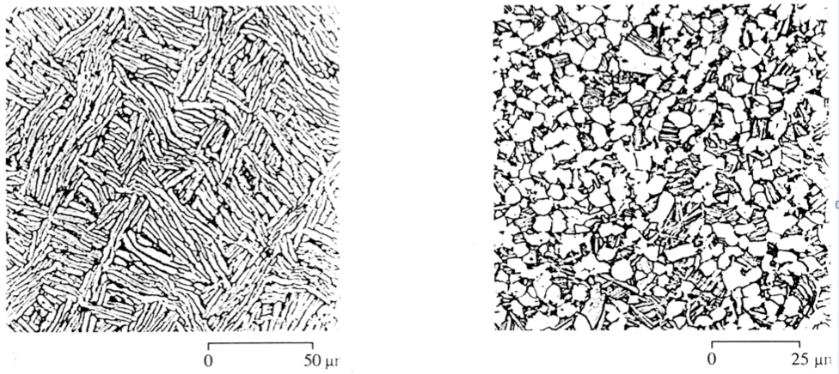
structure - properties - processing
α + β mixtures such as Ti6Al4V are annealed in one of two ways
anneal above 1003°C in the β phase, then cool slowly to allow α phase to form by diffusion. The new grains of α have distinctive flattened shape called Widmanstatten.
anneal at approximately 700°C where it forms equiaxed grains of α and β phase. Then cool slowly whereupon β phase transforms slowly to Widmanstatten grains.
Both heat treatments are examples of strengthening by solute atoms dissolved in each phase and by the refinement of grains by the transformation of β to α phase

Slide 16
BLOCK L: learning objectives
We explored the process-structure-property-principles interrelationships for light alloys using a case study of low a petrol engine piston focussing on Alloys followed by a con rod and Hip stem implant example where the materials selection suggested Mg and Ti alloys.
We Identified the influencing materials properties for designs and be able to generate a materials selection criteria that was then used to select initial appropriate materials for the applications. Additional selection criteria were also explored.
We demonstrated an understanding of the range of materials properties and their associated design requirements
We explored and the interrelationship between manufacturing processes and materials properties and related it back to the structure –properties- principles interaction

